Slide 1
Veterinary Science Employer Survey
DESE Chapter 74 Frameworks

Slide 2
Employer Survey Findings

Slide 3
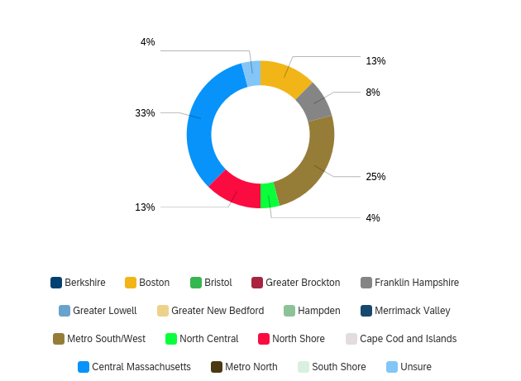
25 Employers Participated

Slide 4
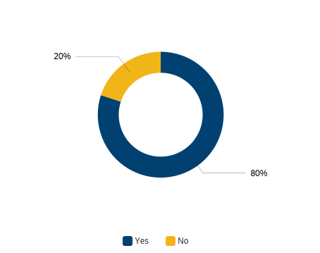
Do you have difficulty finding well-qualified employees for the majority of your jobs?
Key Findings:
Need necessary skills
Limited work experience
Lack of training and proper credentials
Competition from other employers

Slide 5
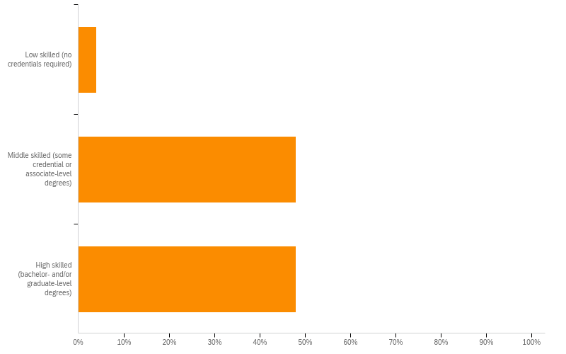
What job levels are hardest to fill in your company?
Key Findings:
13 Veterinary Technician and other related technicians
8 Veterinarians
2 Researchers

Slide 6
Math Skills Key Finding
Math skill deficits were related to measurements and charts

Slide 7
Do you have any other comments on the math skills needed by your workforce?
Every candidate needs to have strong and varies math skills AND have self-confidence and self-awareness (double-check themselves) in using those skills properly and accurately.
Must be able to determine medication dosing
When we hire, we either are clear about expectations or hire those with credentials that assure candidates have these skills.
People nowadays are used to calculators, and most cannot do basic math without the use of it
We constantly do medical drug math, so things like reconstituting drugs, converting from micrograms to milligrams, doing math using concentrations of a drug in liquid form, etc.

Slide 8
Reading, Writing, Language Skills Key Finding
Skill deficits were all related to written communication

Slide 9
Do you have any other comments on the Reading, Writing and Language skills needed by your workforce?
Many high school students and high school graduates need much stronger basic verbal and written communication skills.

Slide 10
Employability Skills Key Finding
Skill deficits reflected in how individuals contribute to the working environment

Slide 11
Do you have any other comments on the employability skills needed by your workforce?
High school graduates need to work harder at professionalism and maturity in the workplace.
I think the key word here is 'most'. In veterinary medicine cultural competence, interpersonal skills, positive attitude, and positive team member skills are often problematic.
So critical today and the teamwork piece is always necessary

Slide 12
Technology Skills Key Finding
Skill deficits tied to specialized software and communications

Slide 13
Medical Tools/Devices Skills Key Finding
Skill deficits in specialty equipment

Slide 14
Digital Literacy Skills Key Finding
Cybersecurity is the only significant skill deficit

Slide 15
Are there any other digital literacy skills are required to perform job-related tasks in your business/company? Please list the skill.
Accuracy, self checking, scheduling appointments and updating records
Basically, being able to learn new skills or software programs that are specific to our needs. We have many automated machines that have their own software. Employees need to be trained to learn our specific equipment and software use.

Slide 16
What medical software program does your practice use?
DogByte, Instinct
Idexx NEO
cornerstone in Dedham, others in MA have Neo, Avimark
word and excel and powerpoint are used in these research settings
Insight (homegrown)
NEO
Idexx Neo
google docs & cattlemax
Neo
if they have prior experiene they know how ot use vet software. if they do not they will be trained
Signature
Ezvet
Depends on the practice. Each likely uses several.
Neo
WoofWare
Cornerstone, Instinct, VitusVet

Slide 17
Certified Veterinary Technician-RVT-Credential and AS degree (25) | Certified Veterinary Assistant (6) | Fear Free (3) | OSHA (2) | Veterinary Technician Specialist (2)
Practice Manager (2) | Certified Manager of Animal Resources | Nutrition | Certified Animal Welfare Administrator | Assistant Lab Animal Technician
Customer Service Manager | Phlebotomy | Anesthesia
What are the top five skill-specific or career-specific certifications that your company values?

Slide 18
What are the top five associate (2-year) degrees that your company values?
Animal Health Care (3) | Veterinary Nursing | Marketing Related | Fundraising Related | Accounting/Business (2)
Biology (3) | Animal Science (2) | Fundraising related | English or similar humanities | general studies
animal training/ behavior | Pharmacology | Diagnostic Imaging (2) | Education

Slide 19
Veterinary Assistant (7) | Customer Service/ Receptionist (11) | kennel assistant/ worker (8) | Animal Care Giver (4) | Technician/Tech Assistant (7)
Inventory Control | general lab assistant | Hospital Assistant (HA) | Maintenance | Volunteer Coordinator
Client Service Representative (CSR) | Administration (referral coordinator, client service coordinator)
What are the top five jobs in your company that only require a high school diploma as a requirement for employment?

Slide 20
When hiring new employees, are there any other types of degrees, credentials, or experiences indicate that an individual has obtained the necessary knowledge and skills for successful job performance?
undergraduate degree in any field is minimum requirement with interest in education
internships, volunteer experience, general work experience involving responsibility and maturity, specialized certification
Too many to list. The industry has 100's of CE or certificates. We value Fear Free & CVA for HS Students.
There are some positions in facilities management, or with corporate work, that would include things like HR certifications, IT certifications, management certifications, talent acquisition certifications.
Prior experience working with youth

Slide 21
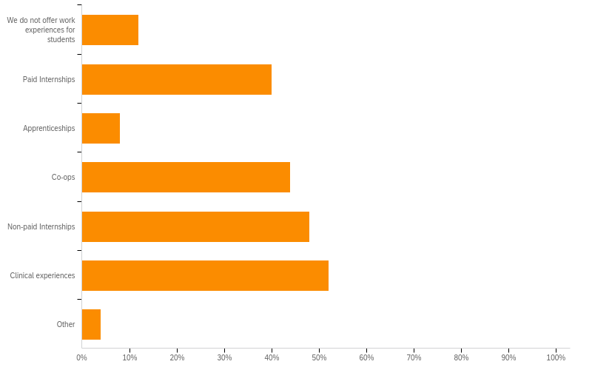
Do you offer work-based learning opportunities for students in your business? If so, please identify all that apply.

Slide 22
Please use the space below to provide additional comments that you believe could assist our local and state educators in maximizing their knowledge and relationships to help better meet the needs of local employers.
With the rise of minimum wage, the lower end jobs have become highly competitive. Previous experience, specialized training in the field or other advanced skill sets will help a candidate to be hired over other candidates.
As noted earlier, the maturity, professionalism, patience, high quality communication skills and a willingness to grow and develop in the job, and understand the value of opportunities offered, are really important. Book learning and good grades are really helpful but each individual must develop a sense of self, true honesty, an open mind to the unique characteristics of each workplace, how opportunities present themselves, and how to behave safely and with empathy in the workplace.
Veterinary assisting is not recognized under the Veterinary practice act in Massachusetts. Only Veterinarians are recognized. Veterinary Technicians (degreed and credentialed technicians) have been fighting for recognition for years. Veterinary assisting is a stepping stone or introduction to the field of veterinary medicine. It currently does not require prior education or a certificate or degree, but Vet assistants do require training to work safely around animals and in Veterinary medicine.

Slide 23
Please use the space below to provide additional comments that you believe could assist our local and state educators in maximizing their knowledge and relationships to help better meet the needs of local employers.
We need your students badly in our industry which is facing critical shortages of nearly all positions so thank you for doing this important work.
There is tremendous shortage of veterinary technicians and veterinarians throughout the northeast and most of the country. There are currently many jobs available.
We are looking for students with drive and initiative - who are critical thinkers. Someone who understands the basics of medical terminology, animal handling/restraint, disinfection safety, and the willingness to learn. We see ALL animals that are brought to us. Therefore, we look for candidates that are comfortable with ALL animals.

Slide 24
Thank you!
Tracey.Bryan@ns4ed.com
Trevor.Stokes@ns4ed.com

